Slide 1


POSTURE GUARD
Smart Wearable for Better Posture
TEAM IGNITRIX

Slide 2

Did you know that back pain affects over 80% of people at some point in their lives?
PROBLEM STATEMENT
Office workers, students, and athletes experience muscle strain due to prolonged
poor posture.
This common issue often goes unnoticed until it leads to serious musculoskeletal
disorders.

Slide 3
Did you know that back pain affects over 80% of people at some point in their lives?
PROBLEM STATEMENT
Office workers, students, and athletes experience muscle strain due to prolonged
poor posture.
This common issue often goes unnoticed until it leads to serious musculoskeletal
disorders.

Slide 4
Did you know that back pain affects over 80% of people at some point in their lives?
PROBLEM STATEMENT
Office workers, students, and athletes experience muscle strain due to prolonged
poor posture.
This common issue often goes unnoticed until it leads to serious musculoskeletal
disorders.

Slide 5
Did you know that back pain affects over 80% of people at some point in their lives?
PROBLEM STATEMENT
Office workers, students, and athletes experience muscle strain due to prolonged
poor posture.
This common issue often goes unnoticed until it leads to serious musculoskeletal
disorders.

Slide 6
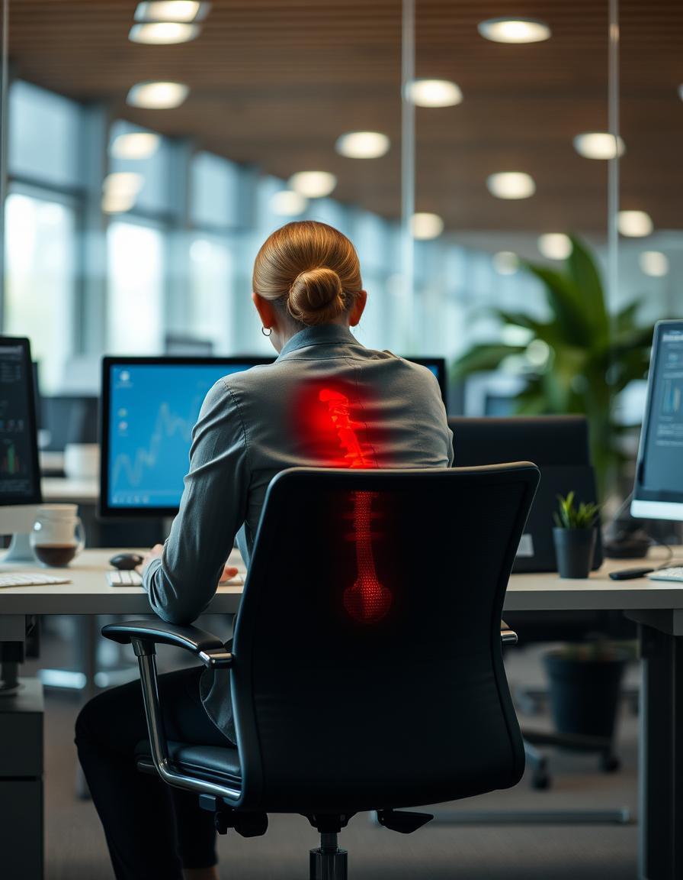





Slide 7
OUR SOLUTION
Wearable Device
- A comfortable band worn on the back.
Sensor Technology
- EMG and IMU sensors detect muscle strain and spinal curvature.
Instant alert and notification on web app
- Vibrates instantly when bad posture is detected and sends a notification

Slide 8
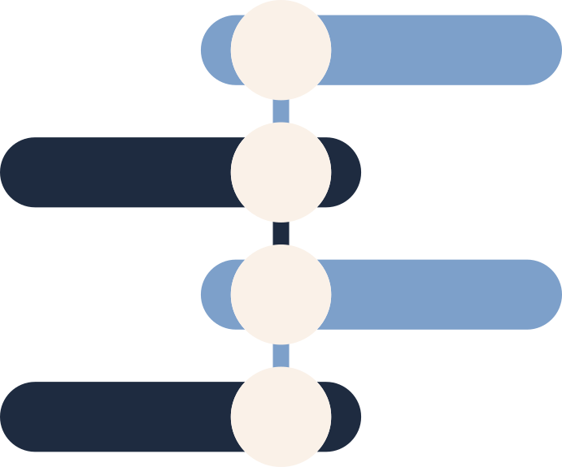


FUNCTIONALITY
EMG Sensor
+
IMU Sensor
ESP32
Vibrator
+
MQTT
Desktop App

Slide 9
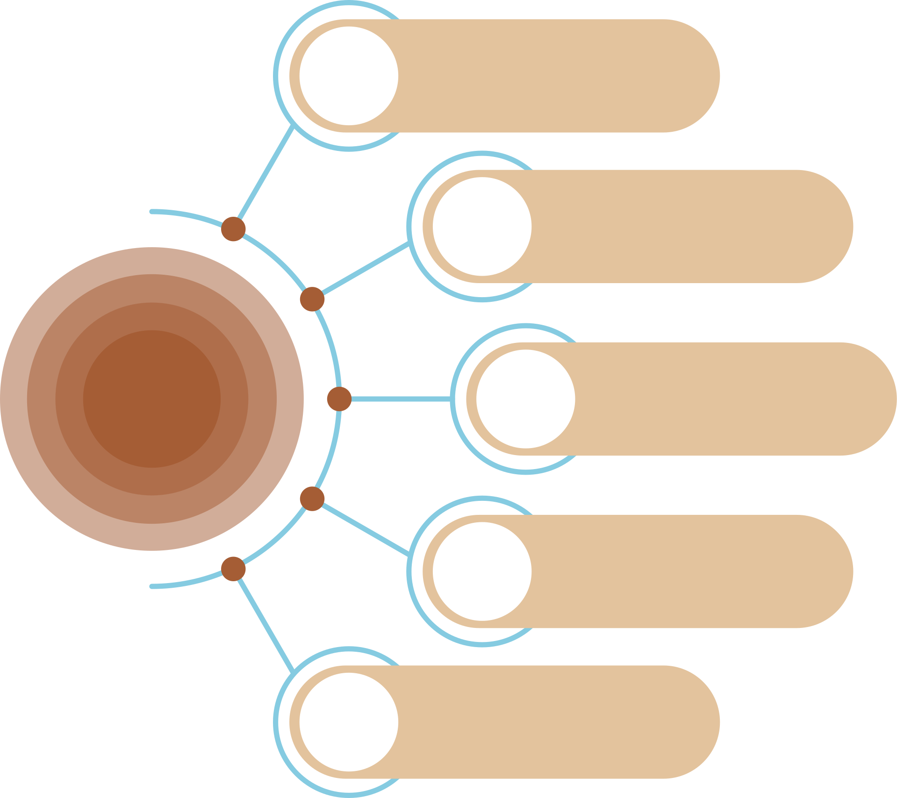


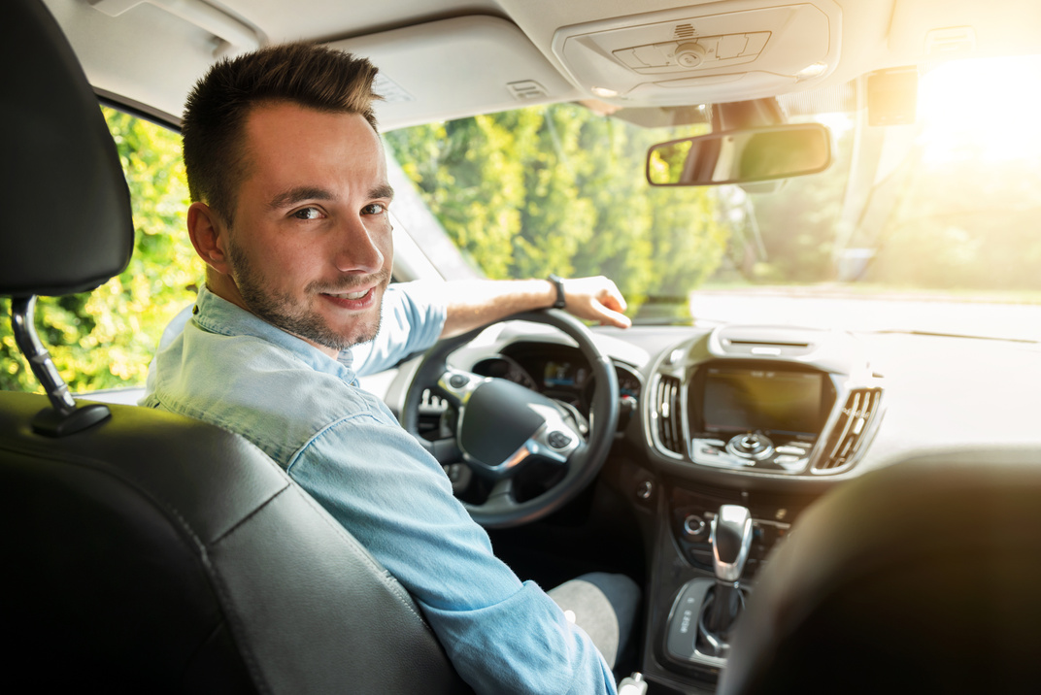
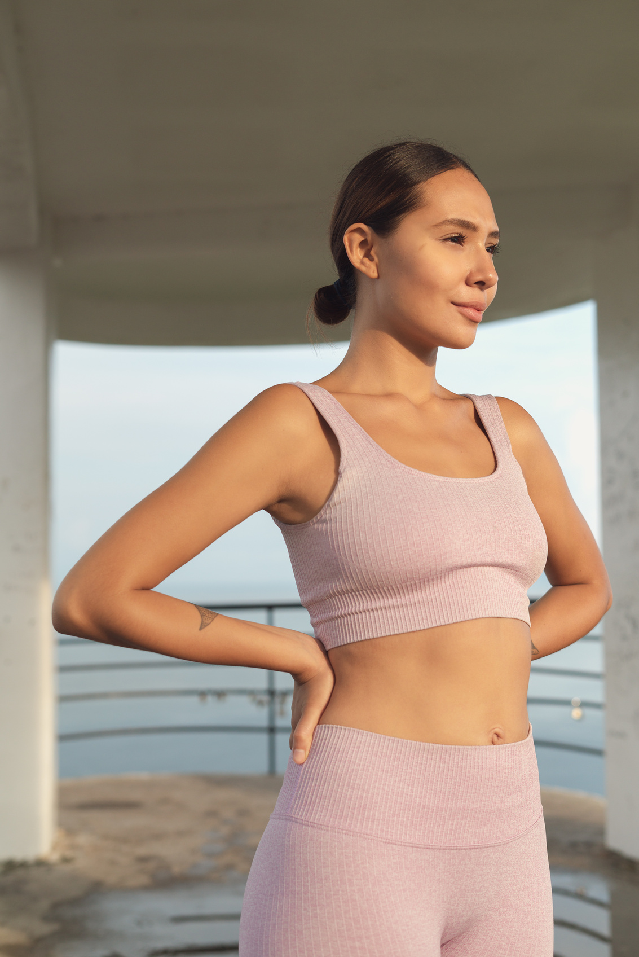
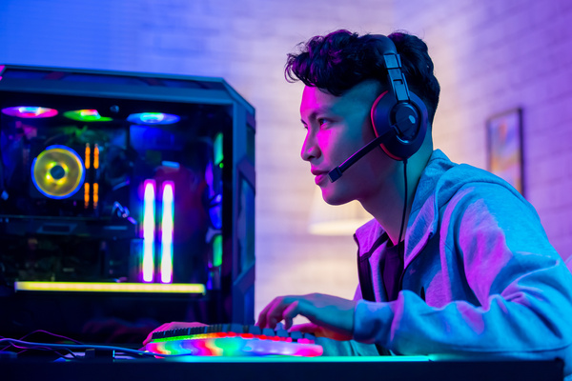
TARGET AUDIENCE
Students &Office Workers
Elderly People
Drivers
Fitness Enthusiasts
Gamers

Slide 10
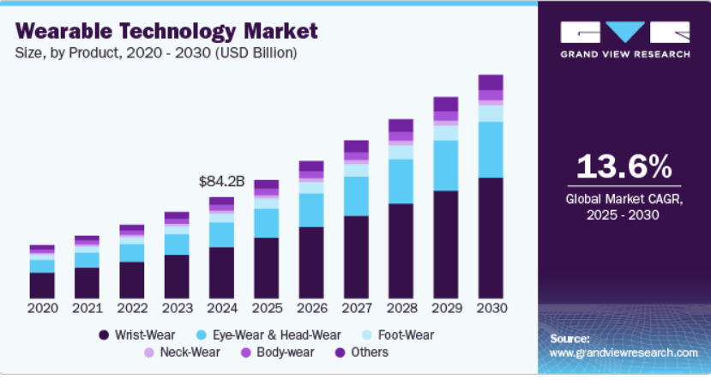
MARKET GROWTH
Global wearable tech market: Valued at $84.2 billion in 2024, expected to grow at a CAGR of 13.6% (2025–2030).
Rising demand due to chronic health conditions, increasing screen time, and ergonomic concerns.

Slide 11

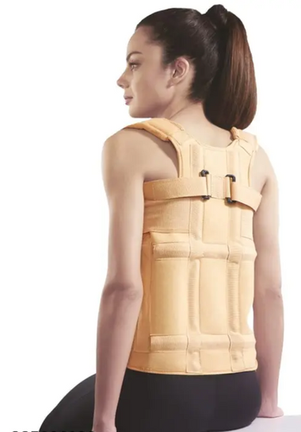
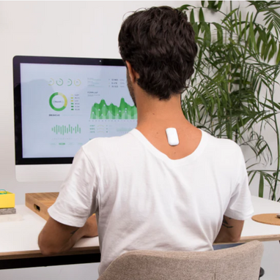


WHY WE ARE DIFFERENT ?
Existing Solutions
Traditional Back Braces
Smart Posture Correctors
Bulky
Lack real time feedback
80$
Expensive

Slide 12

Better than Traditional Braces
More comfortable, no rigid structure
Real-time correction vs. passive support
Better than Other Posture Trackers:
Instant vibration feedback (not just analytics)
Web app integration (long-term posture tracking)
Affordable pricing (more accessible than premium wearables)

Slide 13
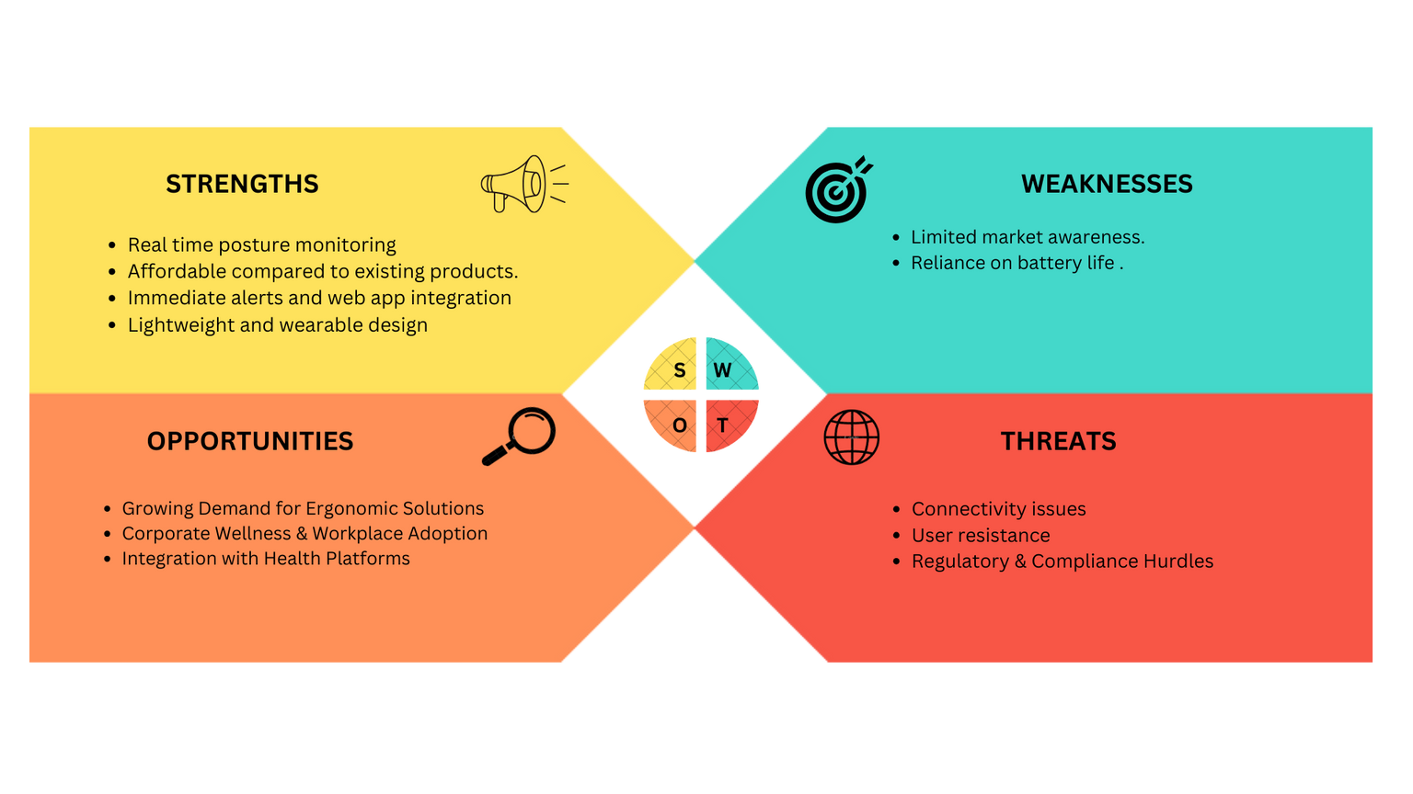
SWOT ANALYSIS

Slide 14

GO-TO-MARKET-STRATEGY
B2B EXPANSION
Partner with corporate wellness programs & insurance providers.
Work with physiotherapists & ergonomic specialists for bulk sales.
DIRECT-TO-CONSUMER
(DTC)
Sell via own website, Daraz, eBay, and wellness stores.
Influencer & digital marketing to target office workers & students.

Slide 15

COST BREAKDOWN
Estimated Product Pricing | Estimated Product Pricing
Item | Price (LKR)
IMU sensor (MPU9250) | 1400
Vibration motor | 300
ESP32 module | 1600
Shoulder strap | 600
Enclosure (Estimated price) | 500
Battery | 600
EMG sensor module | 4000
Final price without emg | 5000
Final price with emg | 9000

Slide 16
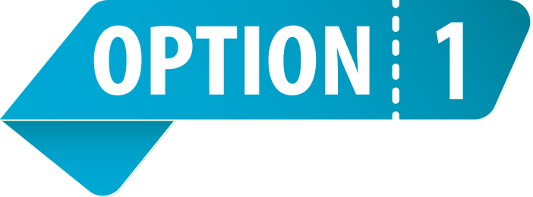


More affordable
For day to day users like students, office workers
Does not include EMG
Expensive compaerd to option 1
Real-time correction vs. passive support
Incldues EMG that gives info on muscle strain
For users who are need of tracking their posture plus muscle strain
ONLY Rs 5000
Price - Rs 9000

Slide 17
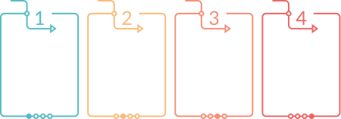
Revenue Plan
Free
Premium
0.99$ per month
Pro
5$ per month
Enterprise
Starting at 30$ per month
Slouch Alerts
&Tips
Progress tracking and Exercise recommendation
Includes EMG sensors to monitor muscle strain
Company dashboards and team health metrices

Slide 18




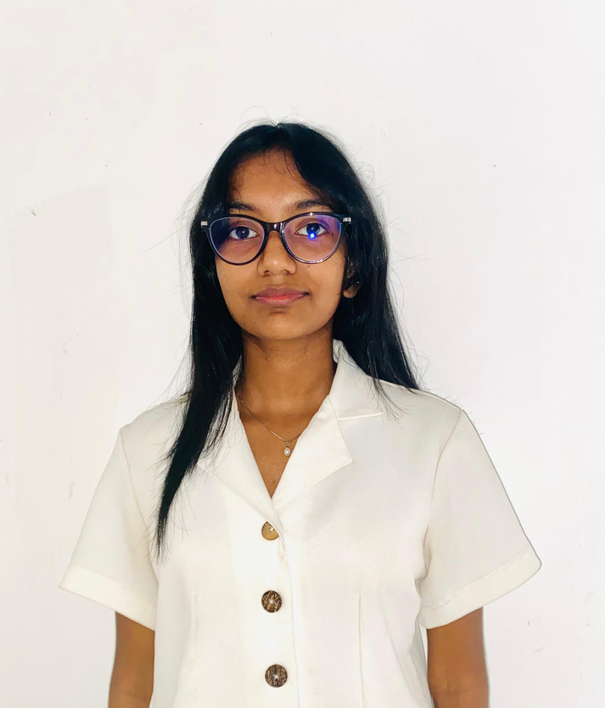
TEAM
Rashane Fernando
Venumi Gunasekara
Pulitha Gunawardana
Dahami Fernando
Roshelle Perera

Slide 19

THANK YOU

